Slide 1
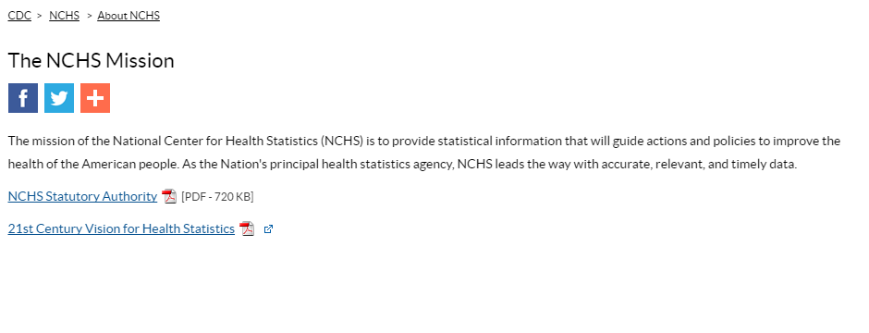

Mission
From https://www.cdc.gov/nchs/about/mission.htm
Notes:
[Presentation made in January 2018, for LIS 526 (University of Washington Library and Information Science course on government publications)]
I’m Eddie Hunsinger, and I’ll be sharing information about the National Center for Health Statistics, or NCHS. The mission of the NCHS is to provide statistical information about the health of Americans, to “guide actions and policies to improve the health of the American people.”

Slide 2
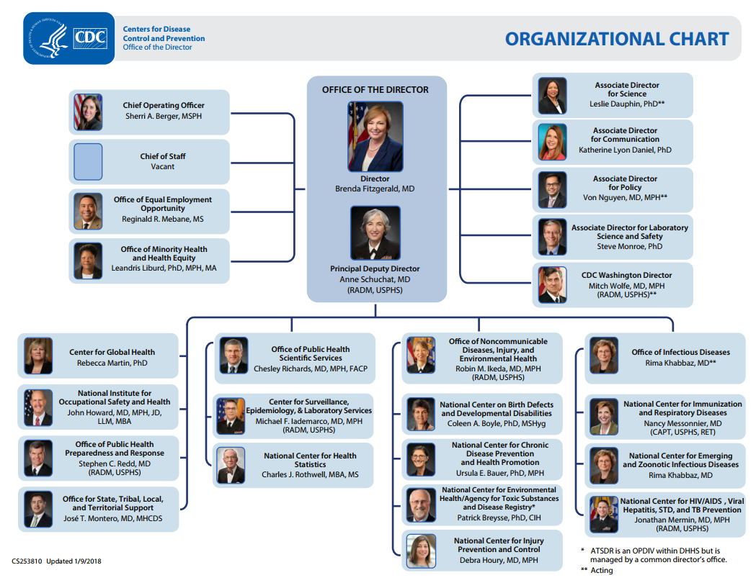
Organizational chart/hierarchy
From https://www.cdc.gov/about/organization/orgchart.htm
https://www.cdc.gov/about/pdf/organization/cdc-photo-org-chart-H.pdf
Notes:
The NCHS is a well-known entity within the Centers for Disease Control, or CDC, and it is one of 18 entities identified in the CDC organizational chart. Within the CDC, it is part of the Office of Public Health and Scientific Services.

Slide 3
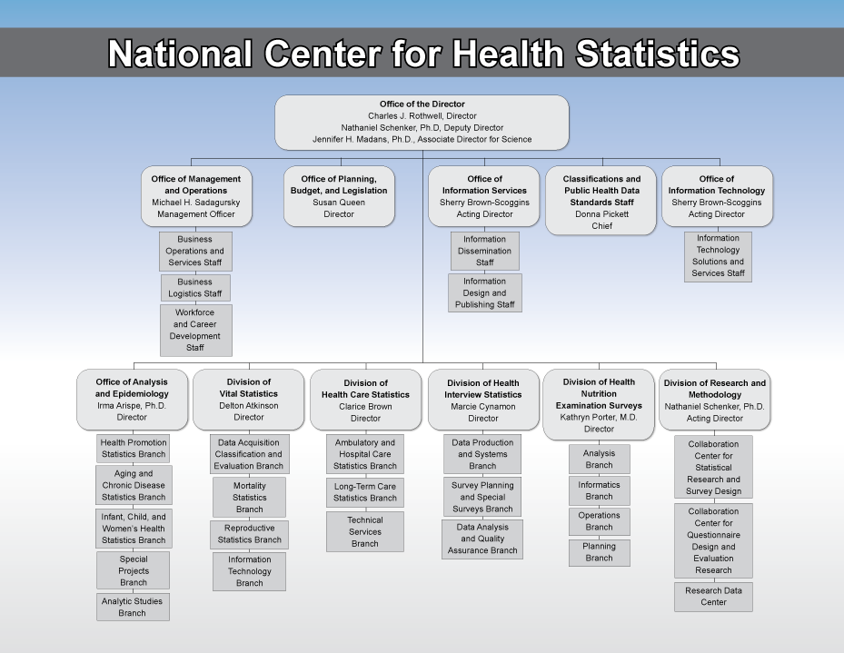
Organizational chart/hierarchy
From https://www.cdc.gov/nchs/about/organization.htm
https://www.cdc.gov/nchs/images/about/nchs_organizational_chart_11-2015.png
Notes:
The NCHS has 11 Offices and Divisions that fall directly under its Director or Management Officer. The NCHS was formed in 1960 as a merger of two entities that existed at that time – the National Office of Vital Statistics and the National Health Survey, and this is reflected in its current mission and offices.

Slide 4
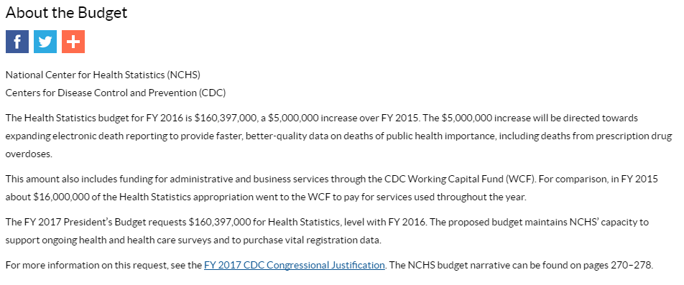
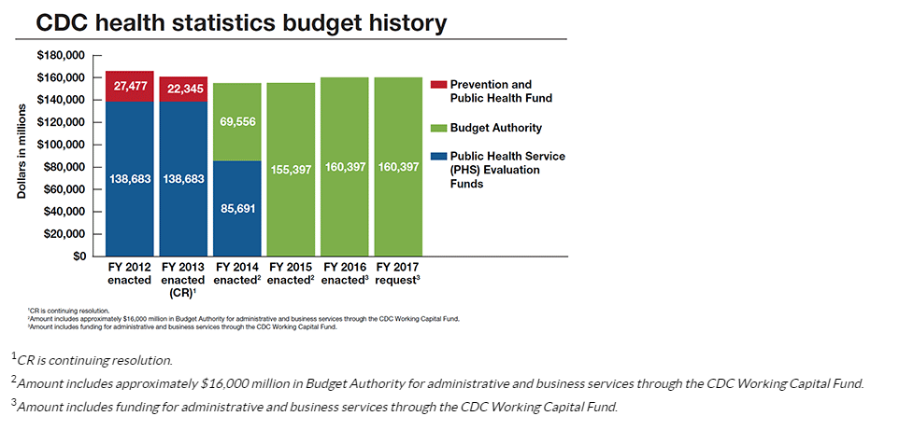
Budget
From https://www.cdc.gov/nchs/about/budget.htm
Notes:
Budget information for the NCHS is included as part of the CDC’s annual budget materials, with reports posted on the NCHS and CDC websites. Since 2012, CDC health statistics funding has been approximately 160 million dollars each year.

Slide 5
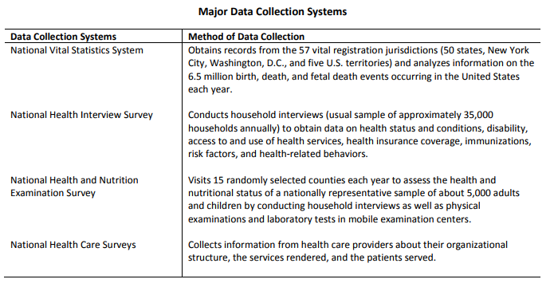
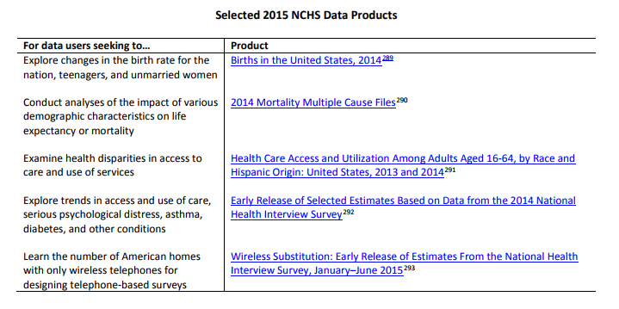
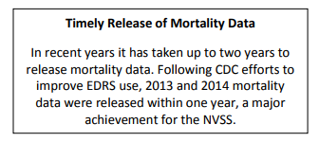
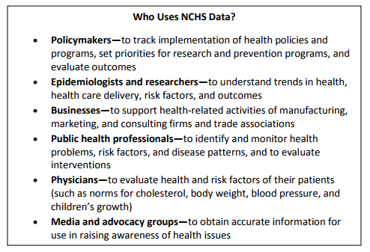
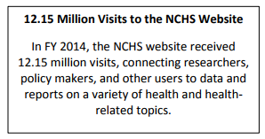
Budget
From https://www.cdc.gov/budget/fy2017/congressional-justification.html
https://www.cdc.gov/budget/documents/fy2017/fy-2017-cdc-congressional-justification.pdf
Notes:
To learn about the budget and work of NCHS in detail, a good place to go is the annual budget-related report entitled CDC Congressional Justification.
Pages 270 to 278 of this report give an overview of NCHS systems, products, and data users.

Slide 6
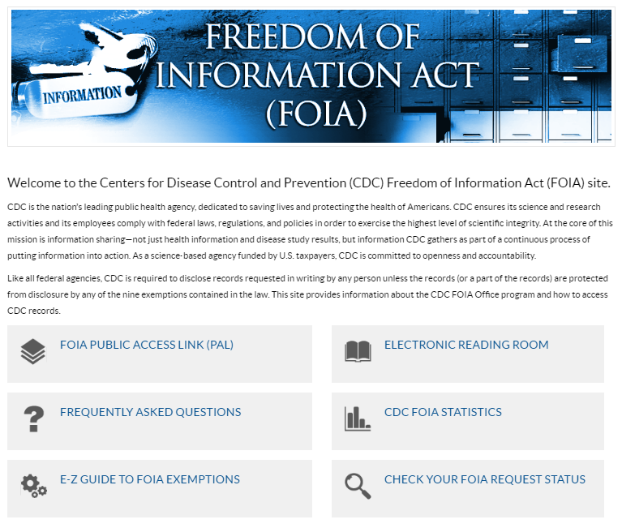
FOIA reading room
From https://www.cdc.gov/od/foia/
Notes:
NCHS’s FOIA page links to the broader CDC FOIA page, and includes a Reading Room with a request log a few reports, as well as its own FAQ page, with answers to questions about FOIA requests to the CDC.

Slide 7
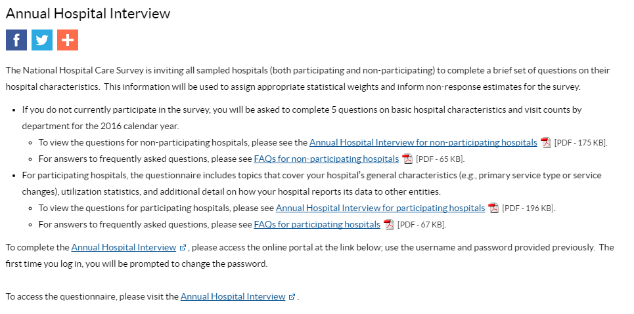
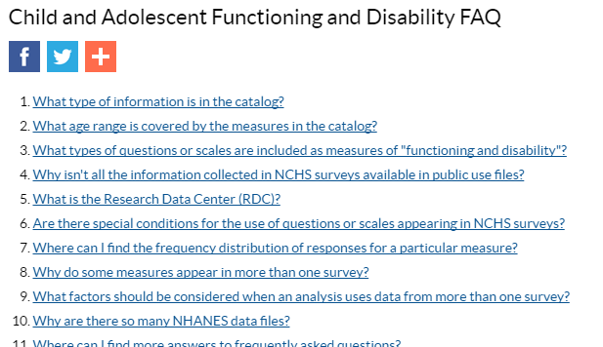
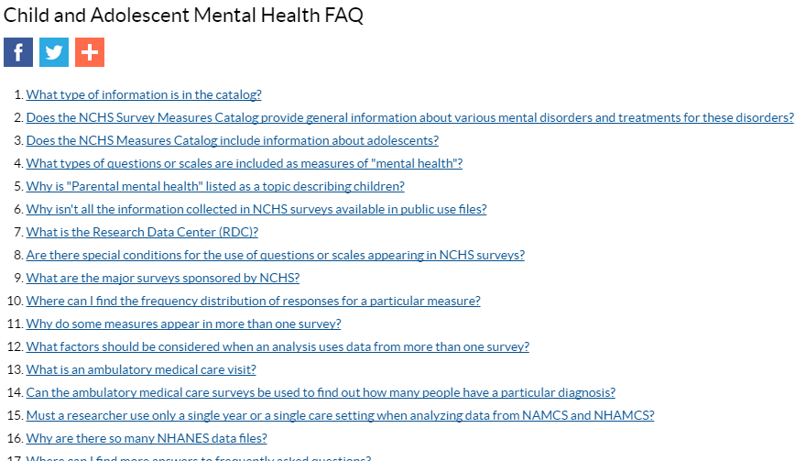
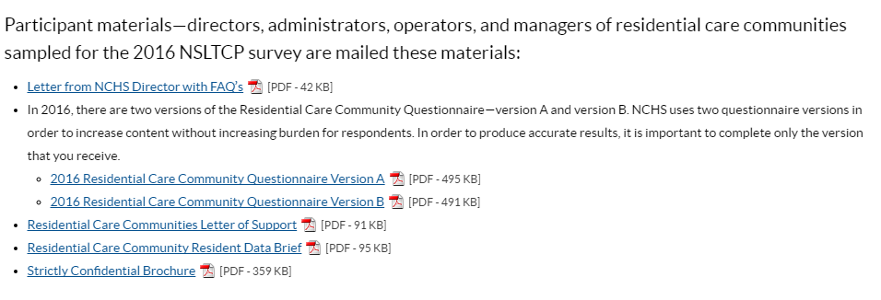
FAQs
From https://www.cdc.gov/nchs/measures_catalog/faq_cafd.htm
https://www.cdc.gov/nchs/nsltcp/rcc_participants.htm
https://www.cdc.gov/nchs/nhcs/annual_hospital_interview.htm
https://www.cdc.gov/nchs/measures_catalog/faq_camh.htm
Notes:
Rather than a single NCHS-wide FAQ page, NCHS has different FAQs for its different programs – because NCHS works on data collection as well as production and dissemination, some of the FAQs are for survey participants, and others are for data users.

Slide 8
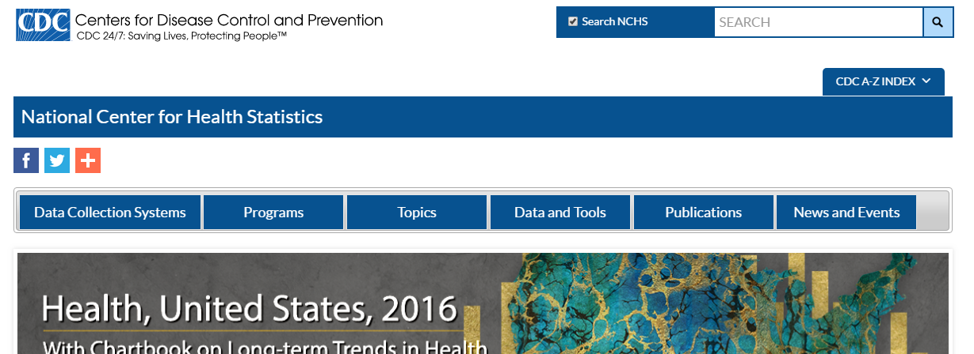

Social media
From https://www.cdc.gov/nchs/index.htm
Notes:
Social media links are posted prominently and in multiple places on the NCHS website, and includes Facebook, Twitter, and YouTube accounts, as well as an RSS feed and a listserv service for emails. The accounts provide interesting health statistics, but don’t seem to be an alert system like some other public health-related social media.

Slide 9
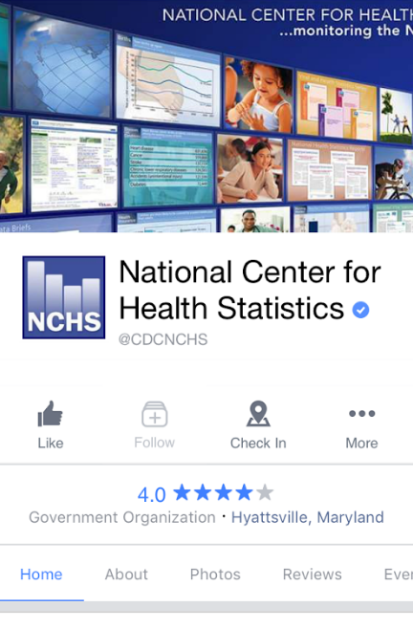
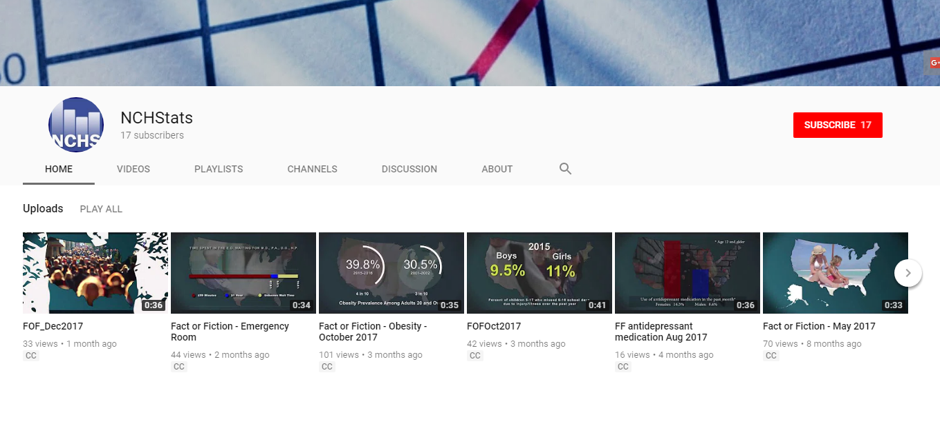
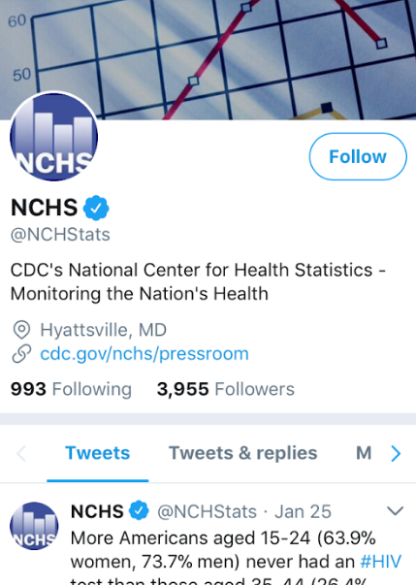
Social media
From Facebook
YouTube
Twitter
Notes:
NCHS’ Facebook account has approximately 21,000 followers, and it’s Twitter account has about 4,000 followers. I found its YouTube page particularly interesting, as it includes some unique content, such as a “Fact or Fiction” series – the page has less than 20 subscribers though.

Slide 10

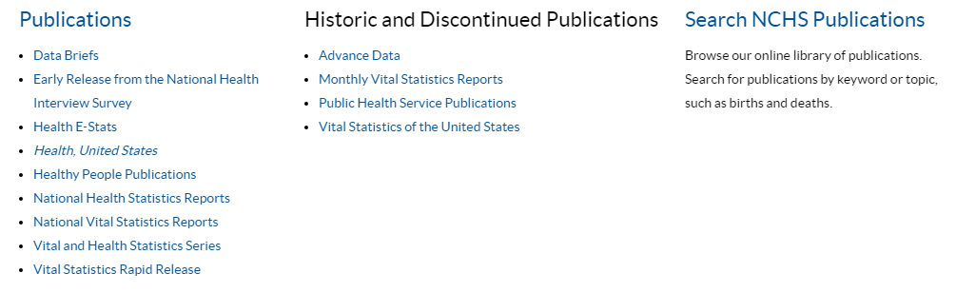

Statistics and data
From https://www.cdc.gov/nchs/index.htm
Notes:
NCHS publications are easily found on the home page, with a menu under “Publications” – I found that navigating can be a little tricky though, because if I click “back” after selecting a publication the Publications menu would be hidden. Also, what look like title banners are often carousels for featured info so not reflective of the full page.

Slide 11
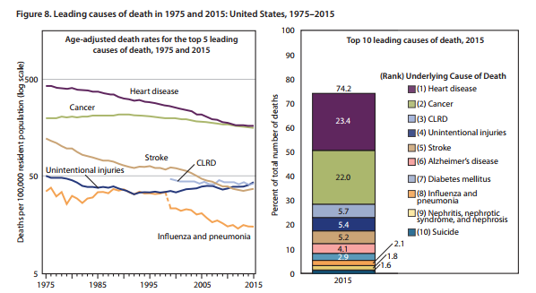
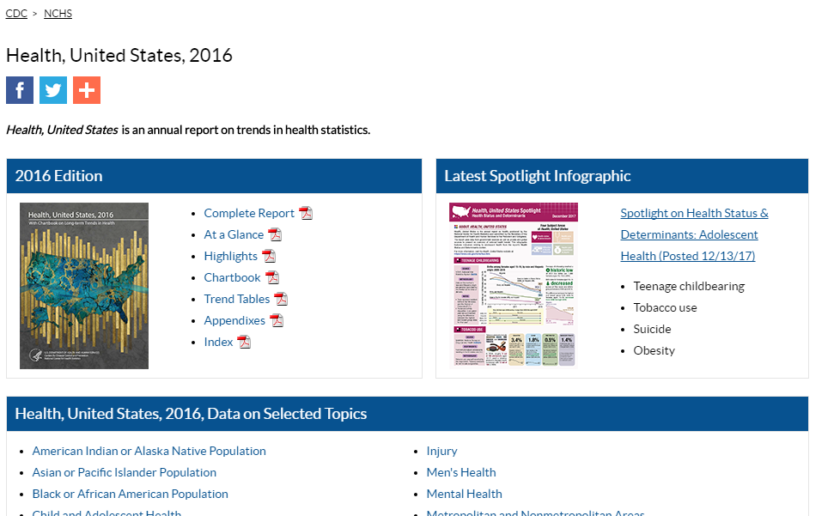
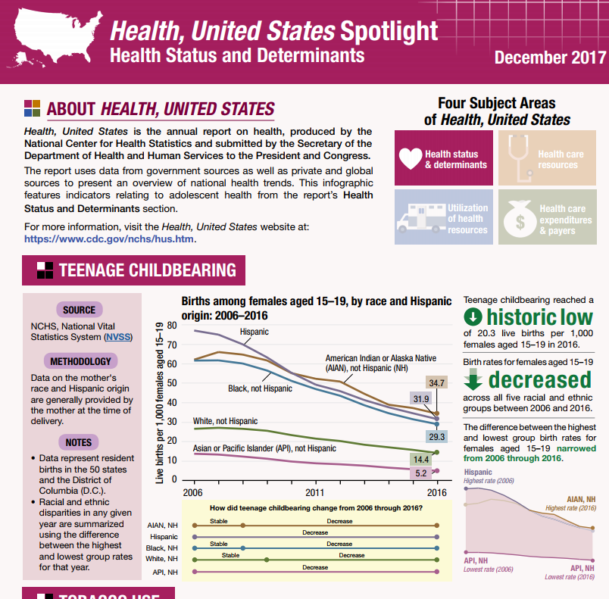
Statistics and data
From https://www.cdc.gov/nchs/hus/index.htm
https://www.cdc.gov/nchs/data/hus/hus16.pdf
https://www.cdc.gov/nchs/hus/spotlight/hus_spotlight_Dec2017_1.pdf
Notes:
While there are many reports regularly provided by NCHS, it does have an overarching annual report as well, entitled Health, United States. The latest version of it is for 2016, and it include vital statistics – that is birth, death, marriage and divorce - information, as well as health and disease information.

Slide 12
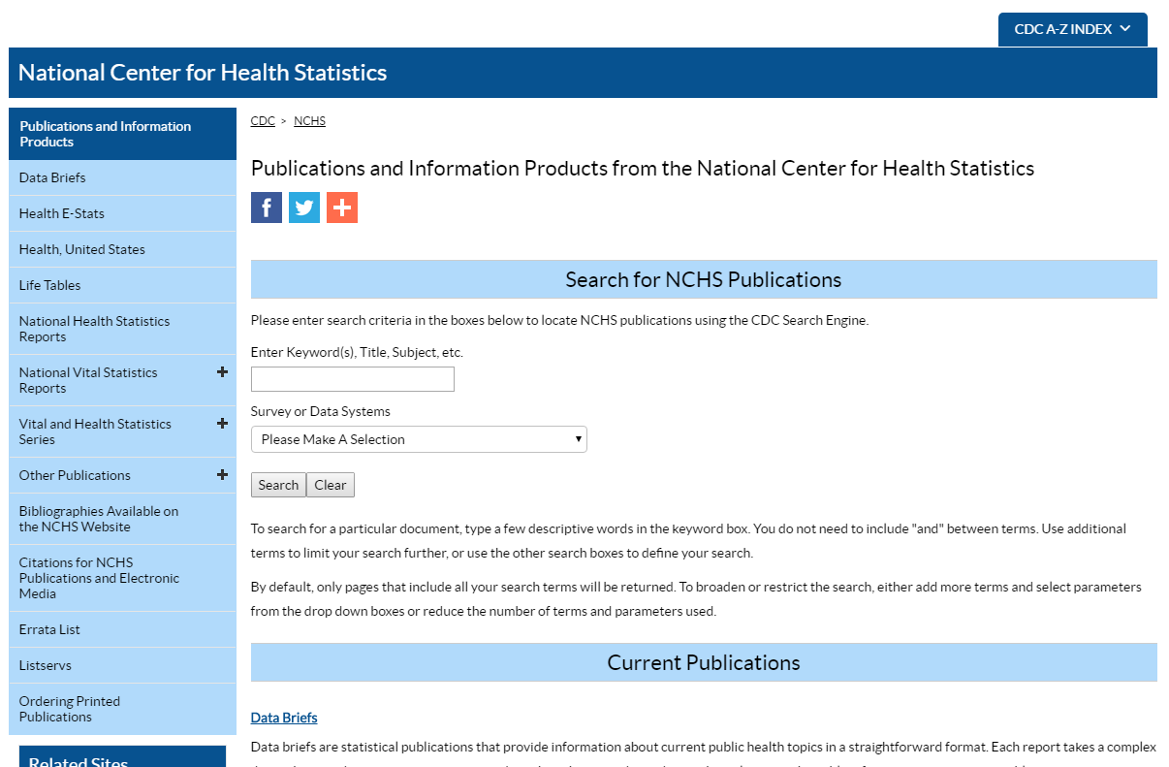
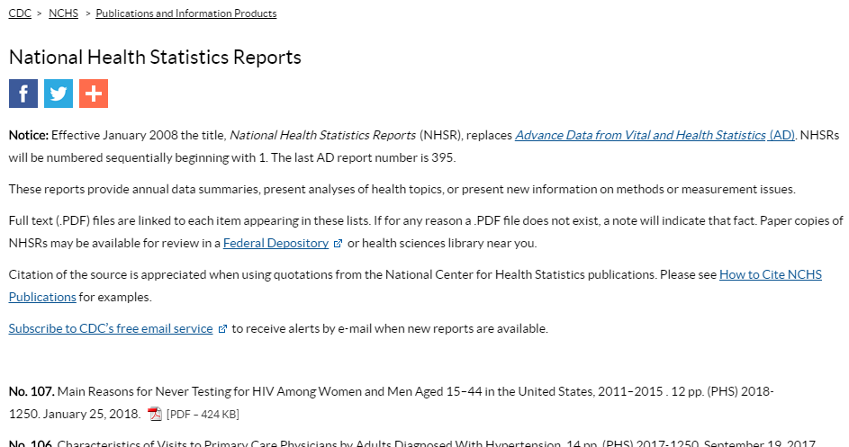
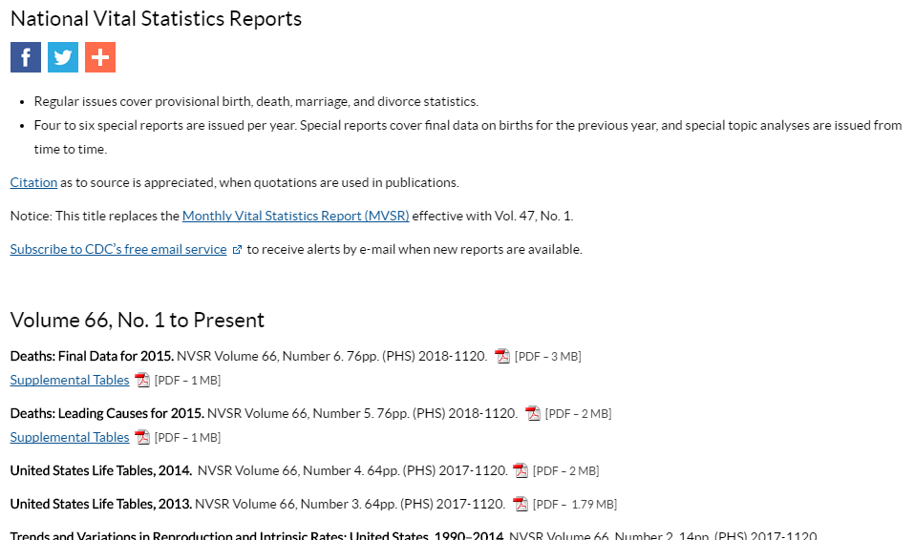
Annual reports
From https://www.cdc.gov/nchs/products/nhsr.htm
Notes:
More detailed and up-to-day reports may be found in groupings within a panel on a publications search page. The major categories for reports are vital statistics and health statistics, but there is some overlap in some reports.

Slide 13



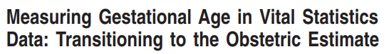

From https://www.cdc.gov/nchs/data/nvsr/nvsr66/nvsr66_06_tables.pdf
https://www.cdc.gov/nchs/data/nvsr/nvsr66/nvsr66_02.pdf
https://www.cdc.gov/nchs/data/nvsr/nvsr66/nvsr66_01_tables.pdf
https://www.cdc.gov/nchs/data/nvsr/nvsr64/nvsr64_05.pdf
https://www.cdc.gov/nchs/nvss/vsrr/drug-overdose-data.htm
https://www.cdc.gov/nchs/nvss/vsrr/natality.htm
https://www.cdc.gov/nchs/nvss/vsrr/mortality.htm
https://www.cdc.gov/nchs/nvss/vsrr.htm
Statistics and data
Notes:
Under vital statistics reports, there are multiple products, such as the National Vital Statistics Reports, with final, authoritative statistics for births and deaths, and fertility and mortality, and the Vital Statistics Rapid Release, with provisional data. Reports are styled distinctly to help users identify them.

Slide 14


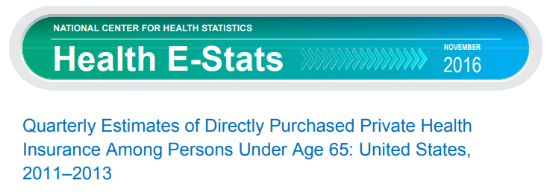

Statistics and data
From https://www.cdc.gov/nchs/data/nhsr/nhsr106.pdf
https://www.cdc.gov/nchs/data/nhsr/nhsr107.pdf
https://www.cdc.gov/nchs/data/hestat/private_health_insurance_11_13/private_health_insurance_11_13.pdf
https://www.cdc.gov/nchs/data/databriefs/db298.pdf
Notes:
Regular health statistics reports include the National Health Statistics Reports, with detailed and authoritative information on health and disease, and products such as Health E-Stats the NCHS data brief, which are packaged for easier access to information.

Slide 15
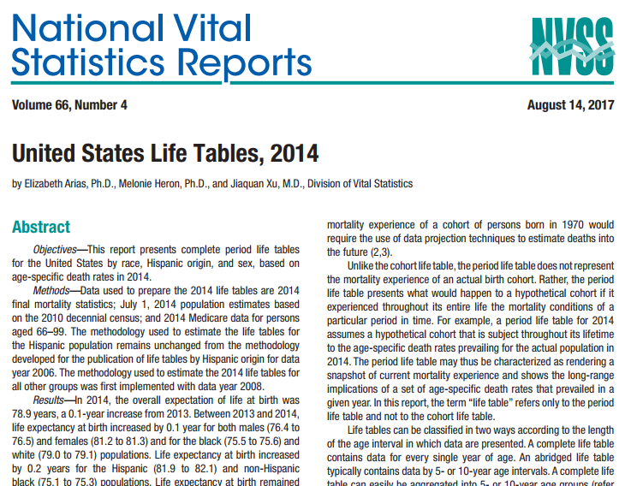
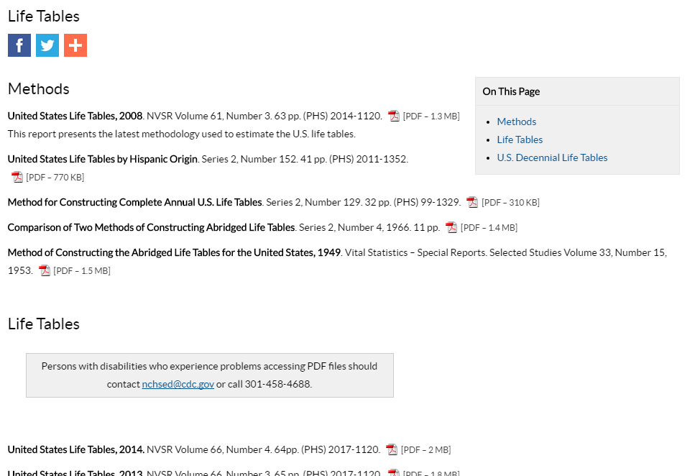
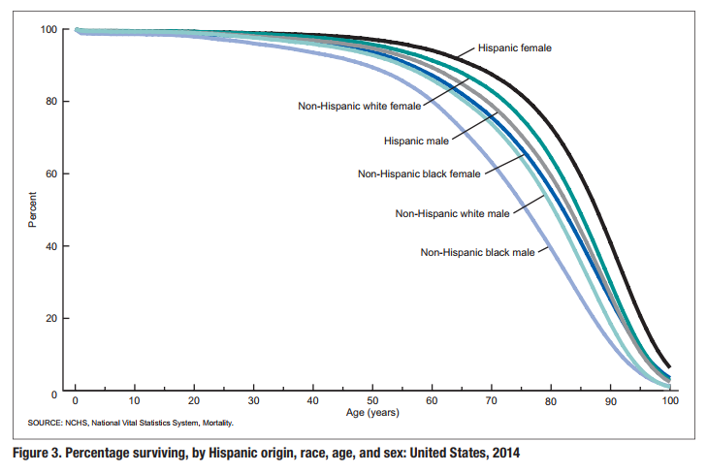
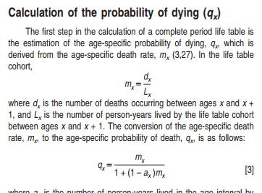
Annual reports
From https://www.cdc.gov/nchs/products/life_tables.htm
https://www.cdc.gov/nchs/data/nvsr/nvsr61/nvsr61_03.pdf
https://www.cdc.gov/nchs/data/nvsr/nvsr66/nvsr66_04.pdf
Notes:
NCHS life tables are reported on in the National Vitals Statistics Reports and stand-alone life table reports, and include important information on mortality for researchers. In addition to the data they provide, they act as technical manuals for many researchers, as the methods provide federal government practices in mortality analysis.

Slide 16
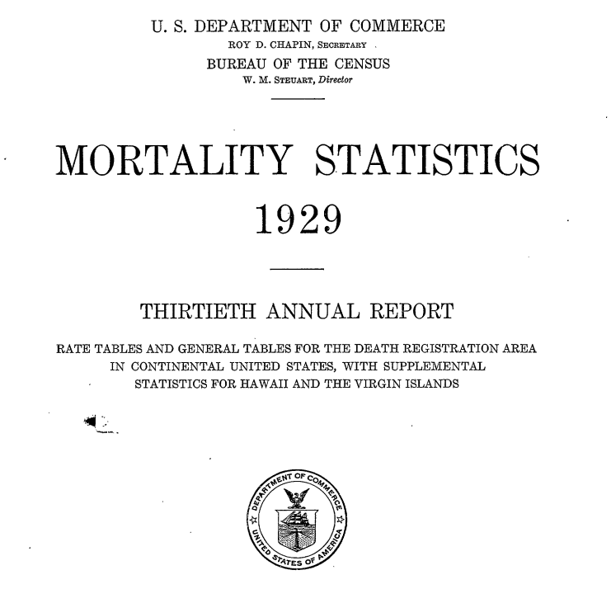
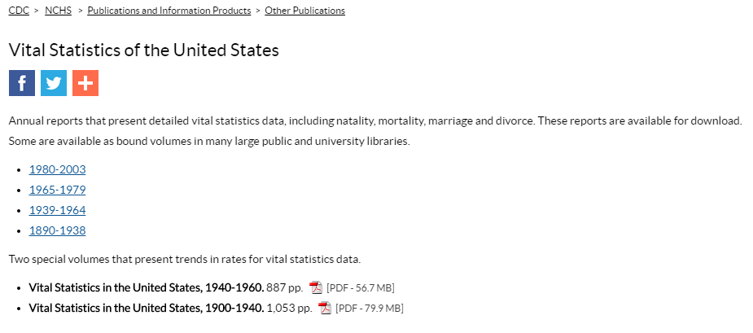
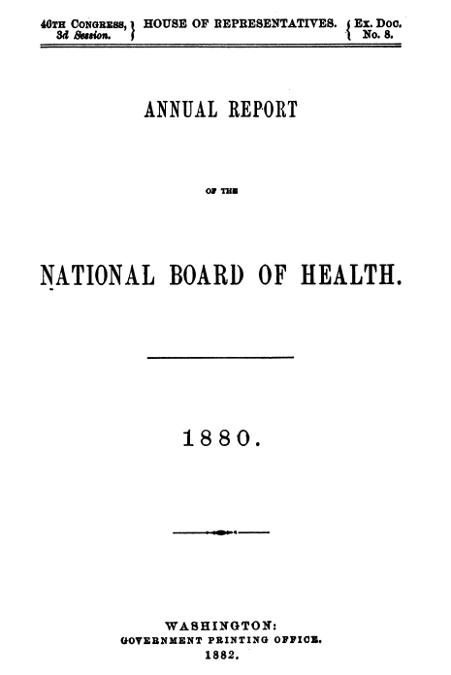
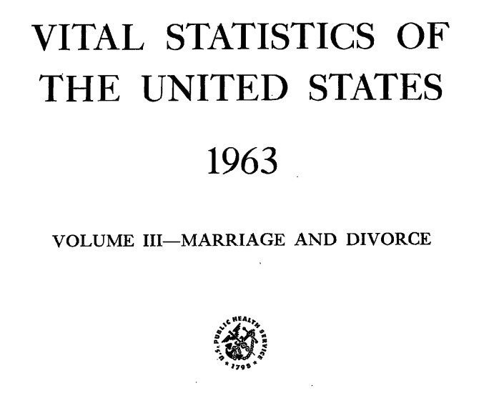
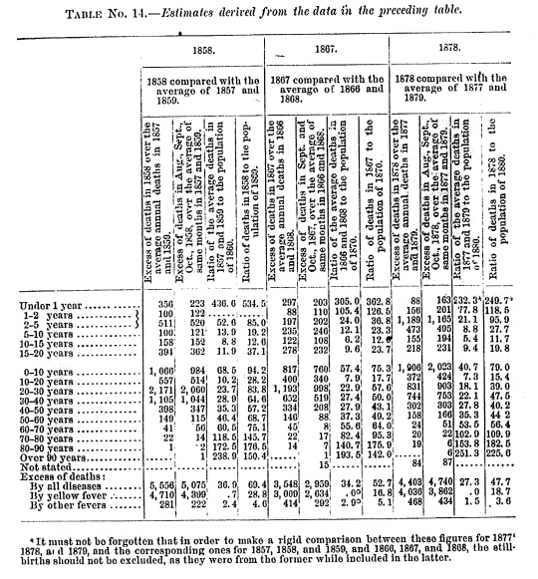
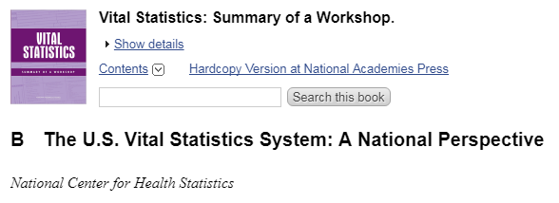

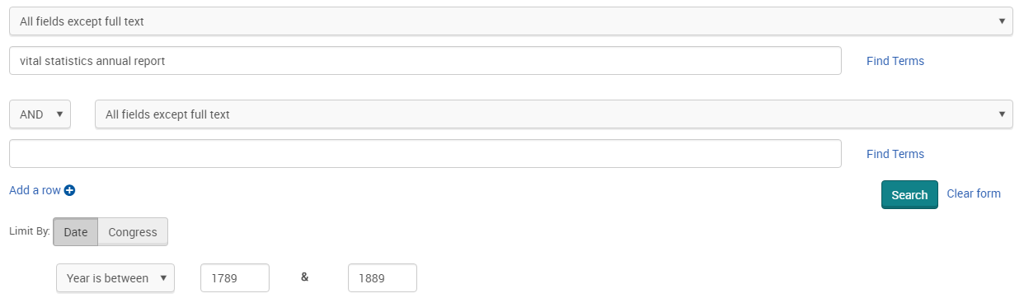
From https://www.cdc.gov/nchs/products/vsus.htm
https://www.cdc.gov/nchs/data/vsushistorical/mortstatsh_1929.pdf
https://www.ncbi.nlm.nih.gov/books/NBK219884/
https://congressional.proquest.com/congressional/docview/t47.d48.1967_h.exdoc.8?accountid=130717
Notes:
Historical data on vital statistics available on the NCHS website goes back to 1890, but reports on mortality prior to 1890 may be found through other government databases. ProQuest Congressional [this one a vendor database, not federal government] provided detailed reports from the short-lived National Board of Health, such as the 1890 Annual Report shown here.

Slide 17
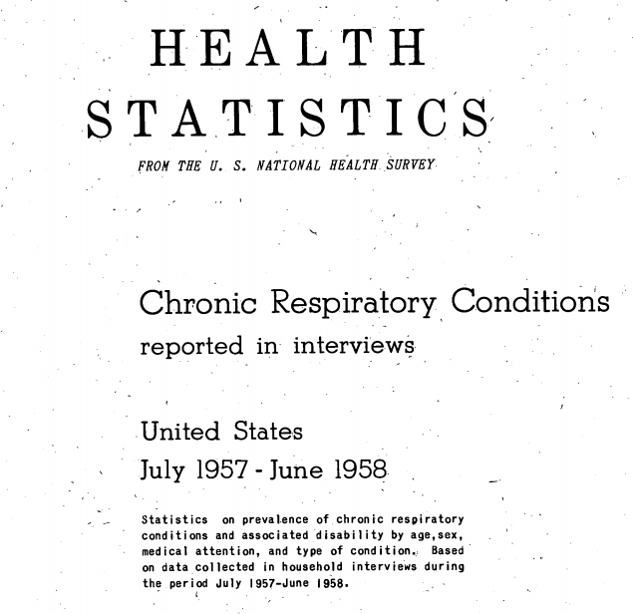
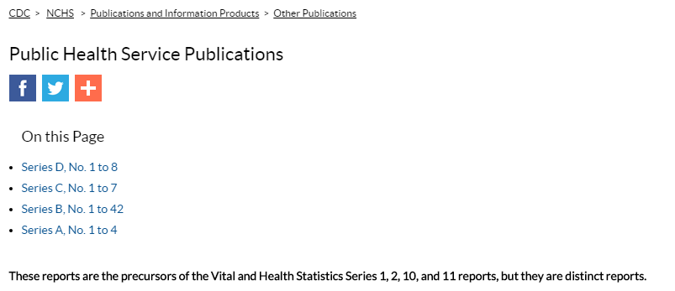
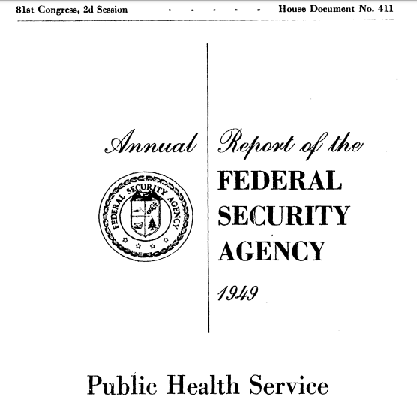
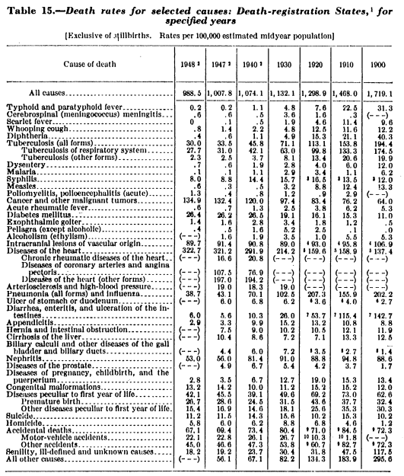
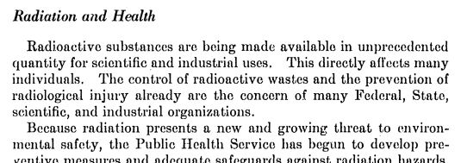
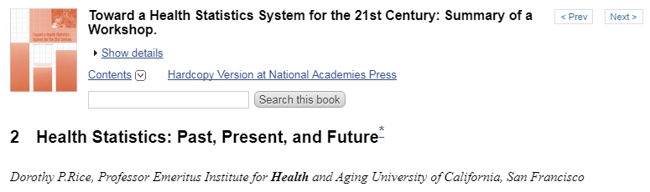
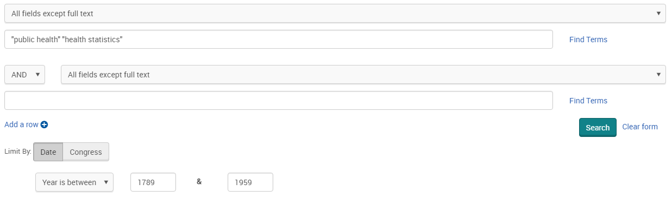
From https://www.cdc.gov/nchs/products/public_health.htm
https://www.cdc.gov/nchs/data/public_health/seriesb_12.pdf
https://www.ncbi.nlm.nih.gov/books/NBK223602/
https://congressional.proquest.com/congressional/docview/t47.d48.11466_h.doc.411?accountid=130717
Notes:
Historical data on health and disease on the NCHS website go back to 1958, and, just as for vital statistics, data for earlier years may be found in other federal government databases. For health statistics, ProQuest Congressional [this one a vendor database, not federal government] returned helpful information from the Public Health Service – a federal public health organization that is still in existence.

Slide 18
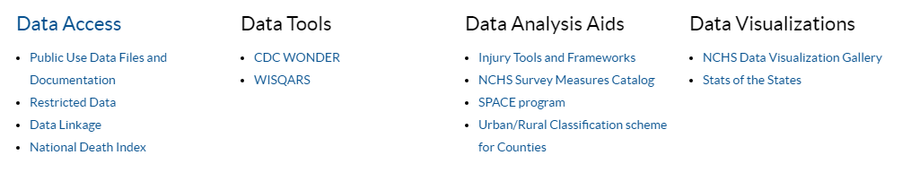
Statistics and data
From https://www.cdc.gov/nchs/index.htm
Notes:
There are many interfaces for accessing, reviewing, and working with NCHS data on the NCHS and CDC websites. Many of these may be found selecting Data and Tools on the main NCHS page, near Publications. While some of the data interfaces are custom to NCHS, other use products from companies as Esri and Tableau.

Slide 19
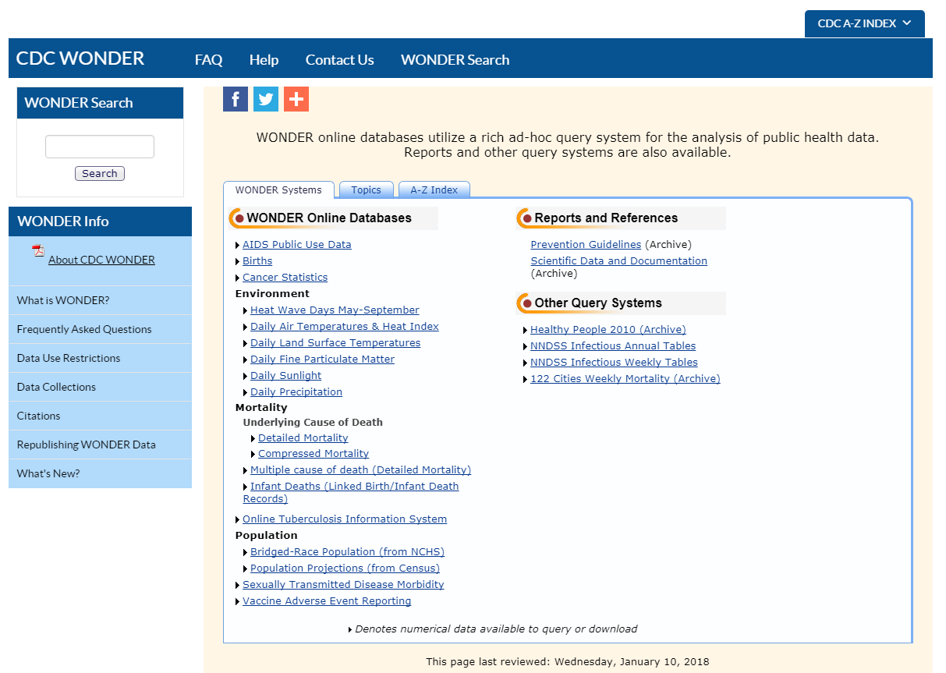
Statistics and data
From https://wonder.cdc.gov/
Notes:
Some NCHS data may be found through the CDC WONDER database – CDC WONDER is a widely-used data access point for NCHS and CDC data, much like the well-known American FactFinder database is for US Census Bureau data.

Slide 20
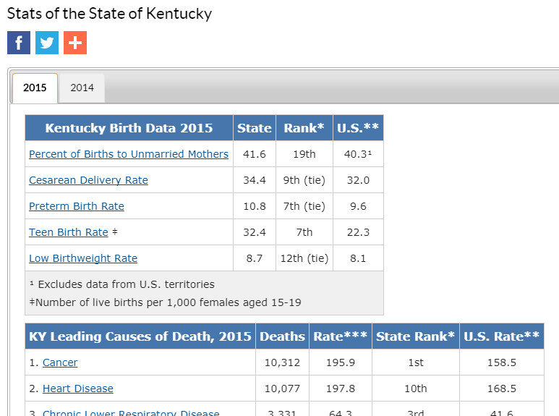
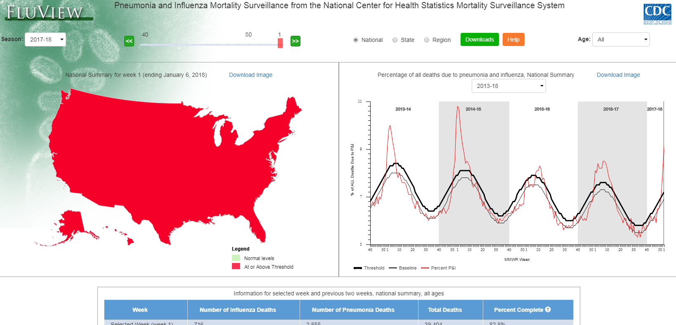

Statistics and data
From https://gis.cdc.gov/grasp/fluview/mortality.html
https://www.cdc.gov/nchs/pressroom/states/kentucky/kentucky.htm
https://www.cdc.gov/injury/wisqars/index.html
Notes:
Other interesting interfaces from NCHS include the “FluView” data base with timely information on influenza and pneumonia and mortality; the web-based Injury Statistics Query and Reporting System; and Stats of the States, with easy-to-access information on health and vital statistics for each US state.

Slide 21
Sources
-About NCHS - Organization. (n.d.). Retrieved January 28, 2018, from https://www.cdc.gov/nchs/about/organization.htm
-About NCHS - The NCHS Budget. (n.d.). Retrieved January 28, 2018, from https://www.cdc.gov/nchs/about/budget.htm
-About NCHS - The NCHS Mission. (n.d.). Retrieved January 28, 2018, from https://www.cdc.gov/nchs/about/mission.htm
-CDC - NCHS - National Center for Health Statistics. (2018a, January 24). Retrieved January 28, 2018, from https://www.cdc.gov/nchs/index.htm
-CDC - NCHS - National Center for Health Statistics. (2018b, January 24). Retrieved January 28, 2018, from https://www.cdc.gov/nchs/index.htm
-CDC - NCHS - National Center for Health Statistics. (2018c, January 24). Retrieved January 28, 2018, from https://www.cdc.gov/nchs/index.htm
-CDC Organization Chart | About | CDC. (2018, January 9). Retrieved January 28, 2018, from https://www.cdc.gov/about/organization/orgchart.htm
-CDC WONDER. (n.d.). Retrieved January 28, 2018, from https://wonder.cdc.gov/
-Congressional Document. (n.d.-a). Retrieved January 28, 2018, from https://congressional.proquest.com/congressional/result/congressional/pqpdocumentview?accountid=130717&groupid=1001177&pgId=24f5139b-1671-435b-ab91-804b43c7c598
-Congressional Document. (n.d.-b). Retrieved January 28, 2018, from https://congressional.proquest.com/congressional/result/congressional/pqpdocumentview?accountid=130717&groupid=1001177&pgId=4706f3f2-1f70-42ba-a144-756d75c264cb
-Driscoll AK, Osterman MJK. Maternal Characteristics of Prenatal WIC Receipt in the United States, 2016. (2018). Retrieved from https://www.cdc.gov/nchs/data/databriefs/db298.pdf
-FluView Phase 7. (n.d.). Retrieved January 28, 2018, from https://gis.cdc.gov/grasp/fluview/mortality.html
-Freedom of Information Act Importance to CDC Mission | CDC. (2018, January 24). Retrieved January 28, 2018, from https://www.cdc.gov/od/foia/index.htm
-Frequently Asked Questions: CDC/ATSDR | FOIA | CDC. (2018, January 24). Retrieved January 28, 2018, from https://www.cdc.gov/od/foia/faqs/index.htm
-FY 2017 | Congressional Justifications | Budget | CDC. (n.d.). Retrieved January 28, 2018, from https://www.cdc.gov/budget/fy2017/congressional-justification.html
-Health, United States, 2014. (2017, December 12). Retrieved January 28, 2018, from https://www.cdc.gov/nchs/data/hus/hus16.pdf
-Health, United States Spotlight (n.d.). Retrieved from https://www.cdc.gov/nchs/hus/spotlight/hus_spotlight_Dec2017_1.pdf
-Mortality Statistics, 1929 (1929) Retrieved from https://www.cdc.gov/nchs/data/vsushistorical/mortstatsh_1929.pdf
-NCHS Survey Measures Catalog - Child and Adolescent Functioning and Disability FAQ. (n.d.). Retrieved January 28, 2018, from https://www.cdc.gov/nchs/measures_catalog/faq_cafd.htm
-NCHS Survey Measures Catalog - Child and Adolescent Mental Health FAQ. (n.d.). Retrieved January 28, 2018, from https://www.cdc.gov/nchs/measures_catalog/faq_camh.htm
-NHCS - Annual Hospital Interview. (n.d.). Retrieved January 28, 2018, from https://www.cdc.gov/nchs/nhcs/annual_hospital_interview.htm
-NCHS - National Health Statistics Reports, Characteristics of Visits to Primary Care Physicians by
-Adults Diagnosed With Hypertension (2017). Retrieved January 28, 2018, from https://www.cdc.gov/nchs/data/nhsr/nhsr106.pdf
-NCHS - National Health Statistics Reports, Main Reasons for Never Testing for HIV Among Women and Men Aged 15–44 in the United States, 2011–2015. (2018). Retrieved January 28, 2018, from https://www.cdc.gov/nchs/data/nhsr/nhsr107.pdf
-NSLTCP - Residential Care Communities Study Participants. (n.d.). Retrieved January 28, 2018, from https://www.cdc.gov/nchs/nsltcp/rcc_participants.htm
-Arias E. United States Life Tables, 2008. (2012). Retrieved from https://www.cdc.gov/nchs/data/nvsr/nvsr61/nvsr61_03.pdf
-Martin JA, Osterman MJK, Kirmeyer SE, Gregory ECW. National Vital Statistics Reports, Measuring Gestational Age in Vital Statistics Data: Transitioning to the Obstetric Estimate. (2015). Retrieved from https://www.cdc.gov/nchs/data/nvsr/nvsr64/nvsr64_05.pdf
-National Center for Health Statistics. Births: Final Data for 2015. (2017). Retrieved from https://www.cdc.gov/nchs/data/nvsr/nvsr66/nvsr66_01_tables.pdf
Sources

Slide 22
Sources, continued
-Hamilton BE, Kirmeyer SE. National Vital Statistics Reports, Trends and Variations in Reproduction and Intrinsic Rates: United States, 1990–2014. (2017). Retrieved from https://www.cdc.gov/nchs/data/nvsr/nvsr66/nvsr66_02.pdf
-Arias E, Heron M, Xu JQ. National Vital Statistics Reports, United States Life Tables, 2014. (2017). Retrieved from https://www.cdc.gov/nchs/data/nvsr/nvsr66/nvsr66_04.pdf
-Arias E, Heron M, Xu JQ. National Vital Statistics Reports, United States Life Tables, 2014. (2017). Retrieved from https://www.cdc.gov/nchs/data/nvsr/nvsr66/nvsr66_06_tables.pdf
-Zammitti EP, Cohen RA. Health E-Stats, Quarterly Estimates of Directly Purchased Private Health Insurance Among Persons Under Age 65: United States, 2011–2013. (2016). Retrieved from https://www.cdc.gov/nchs/data/hestat/private_health_insurance_11_13/private_health_insurance_11_13.pdf
-Products - Life Tables - Homepage. (2017, November 7). Retrieved January 28, 2018, from https://www.cdc.gov/nchs/products/life_tables.htm
-NCHS - Public Health Service Publications. (n.d.). Retrieved January 28, 2018, from https://www.cdc.gov/nchs/products/public_health.htm
-Products - Vital Statistics of the US - Homepage. (n.d.). Retrieved January 28, 2018, from https://www.cdc.gov/nchs/products/vsus.htm
-Products - Vital Statistics Rapid Release - Homepage. (2017, November 3). Retrieved January 28, 2018, from https://www.cdc.gov/nchs/nvss/vsrr.htm
-Products - Vital Statistics Rapid Release - Mortality. (2017, November 3). Retrieved January 28, 2018, from https://www.cdc.gov/nchs/nvss/vsrr/mortality.htm
-Products - Vital Statistics Rapid Release - Natality. (2017, November 3). Retrieved January 28, 2018, from https://www.cdc.gov/nchs/nvss/vsrr/natality.htm
-Products - Vital Statistics Rapid Release - Provisional Drug Overdose Data. (2018, January 12). Retrieved January 28, 2018, from https://www.cdc.gov/nchs/nvss/vsrr/drug-overdose-data.htm
-U.S. Department of Health, Education, and Welfare. Chronic Respiratory Conditions Reported in Interviews, United States, July 1957-June 1958. (1959). Retrieved from https://www.cdc.gov/nchs/data/public_health/seriesb_12.pdf
-Statistics, N. R. C. (US) C. on N. (2009). The U.S. Vital Statistics System: A National Perspective. National Academies Press (US). Retrieved from https://www.ncbi.nlm.nih.gov/books/NBK219884/
-Statistics, N. R. C. (US) C. on N., Perrin, E. B., Kalsbeek, W. D., & Scanlan, T. M. (2001). Health Statistics: Past, Present, and Future. National Academies Press (US). Retrieved from https://www.ncbi.nlm.nih.gov/books/NBK223602/
-Stats of the State of Kentucky. (2017, August 14). Retrieved January 28, 2018, from https://www.cdc.gov/nchs/pressroom/states/kentucky/kentucky.htm
-WISQARS (Web-based Injury Statistics Query and Reporting System)|Injury Center|CDC. (2018, January 11). Retrieved January 28, 2018, from https://www.cdc.gov/injury/wisqars/index.html
Sources

